Slide 1
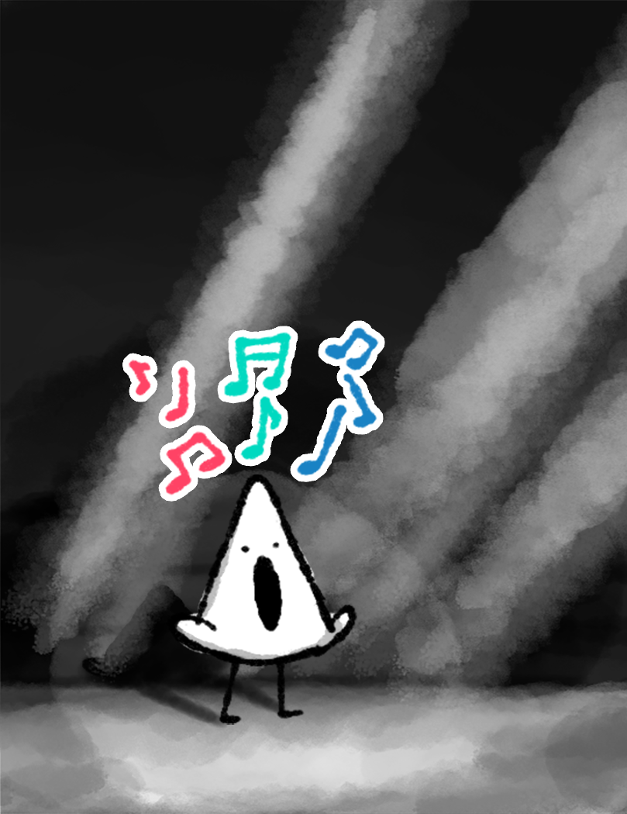
Ongoing Design Document
Lullaby

Slide 2

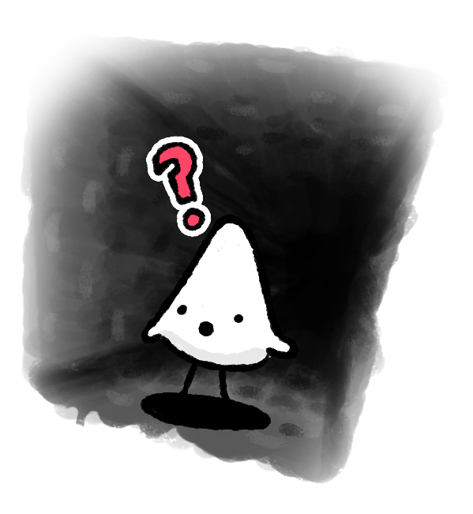

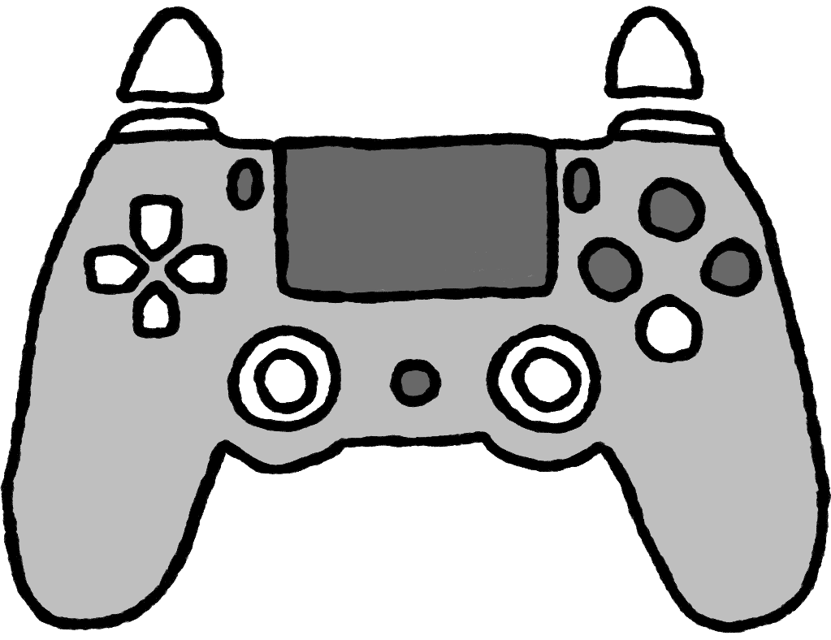
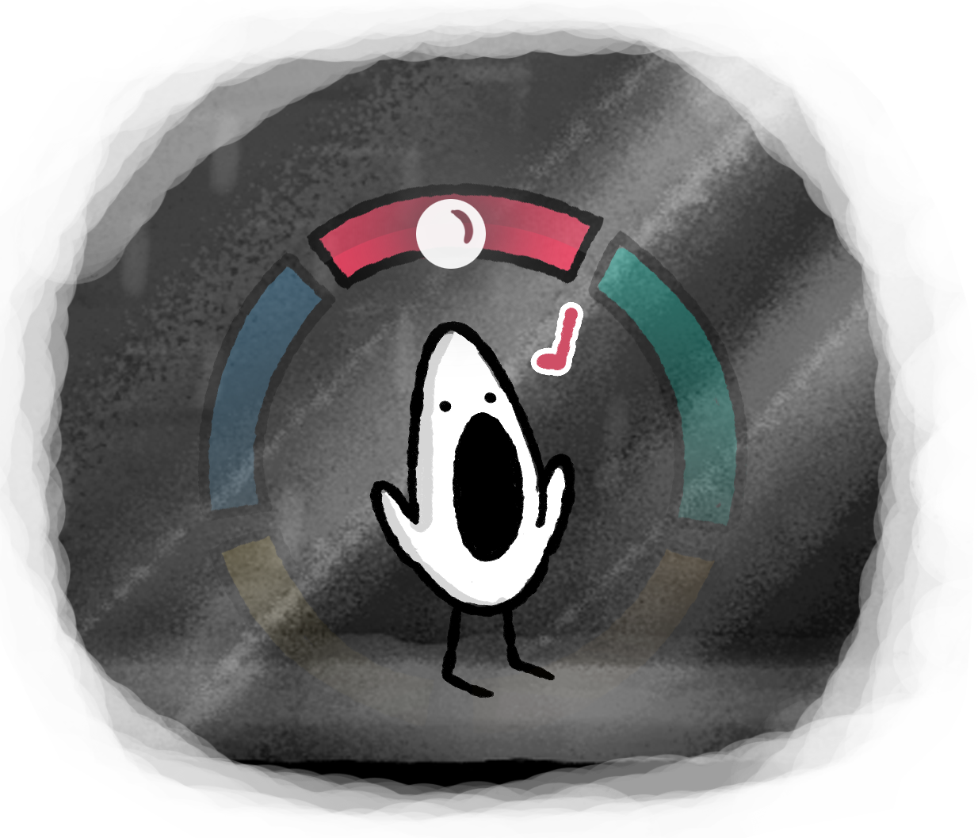
Character and Mechanics (In Progress)
Main Character
In lullaby, you control a small character (the MC) inhabiting a big world.
Lacking physical prowess, the MC is not very strong or agile. They move through the large dungeon at a moderate pace and they’re able to perform a small jump.
Singing in Lullaby
In Lullaby, music and song are the main ways to manipulate the environment. Moving the Right Analog Stick Will reveal the Note Wheel.In order to sing, you highlight your desired note with the right analog stick, and then press R2/L2 to sing the note.
If just starting to sing, the character will need to briefly ease into the note. The Loudness of the MC’s sining depends on how hard the trigger is squeezed.
When starting to sing or shifting notes mid-song, there
is a slight delay before it is registered in the code as an input.-
This is in order to avoid accidental notes with the analog stick.
Singing Cont.
The MC is able to hold multiple notes at a time, letting them sing in several pitches at once, even chords!
If the player wishes to select multiple notes, they can enable the Hold Mode by simply hold down the R1/L1 button. Now they can select up to three notes at a time, allowing for more advanced environment interaction.
Held notes are indicated by them breaking from the wheel slightly, until they are no longer held.
Notes:
Input beside analog stick is still undecided :)
There is more to say about these mechanics. For example, the bottom left image illustrates a fade-effect on the wheel tied to the proximity of the cursor, I think that may be a way to make the wheel less visually distracting, while providing all the information the player needs. You can see a rough concept of the wheel in motion here: https://drive.google.com/file/d/1GqEScJ9HmWn5Gnl5OOax5IXXVS7FnQ4H/view?usp=sharing (Note, the video doesn’t illustrate visual effects much, and there is no fade-effect present as in the bottom right photo)

Slide 3

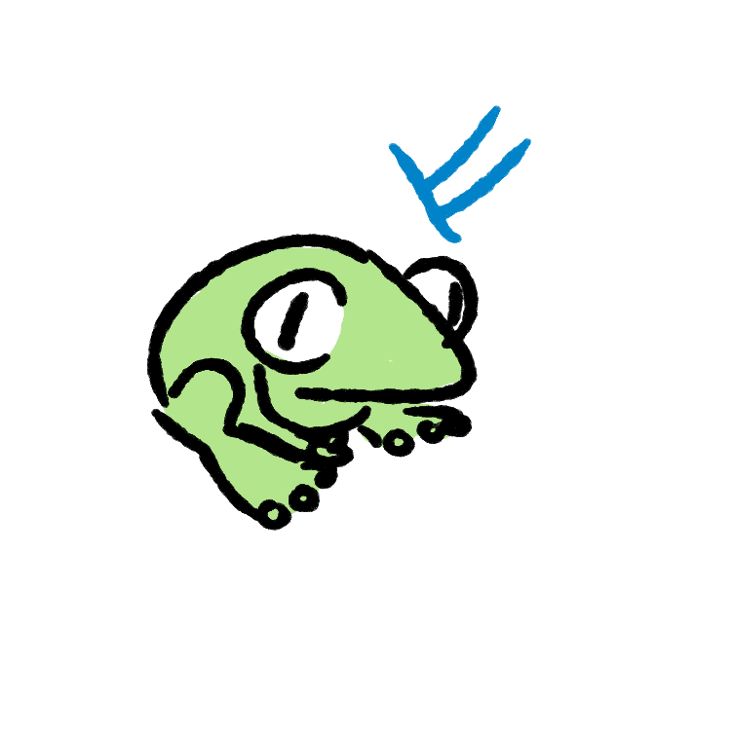
Game World and Progression
Lullaby features a semi-linear world-layout, where the map occasionally branches, but ultimately pushes a main path. Stopgaps throughout the dungeon will require players to explore the dungeon to unlock new notes to play.
Branching paths and exploration
As they player progresses, they will eventually stumble upon objects that they are not able to fully interact with yet. For this they will have to venture out to learn new notes. The player initially has three?
Learning notes
At the ends of branches will be special items or characters that teach you new notes. Perhaps one branch could end with a puzzle where you have to hit a big bell to learn its note. Or you may learn a new note from listening to a small family of croaking frogs.
Player environment influence
Music has abandoned the dungeon, only disparate elements remain: steady drips into a puddle, lonely winds, sounds from animals etc.
As the player progresses through levels, these musical elements gradually unite to form into a background track, which is contained within a section of the game.
As the player explores and sings throughout the dungeon, their positive influence may be felt in the environment. As you sing, perhaps colours begin to linger and plants slowly sprout in the walls.
With these proposals, backtracking through the branching paths would provide the player with a nice indication of their impact and progression.

Slide 4
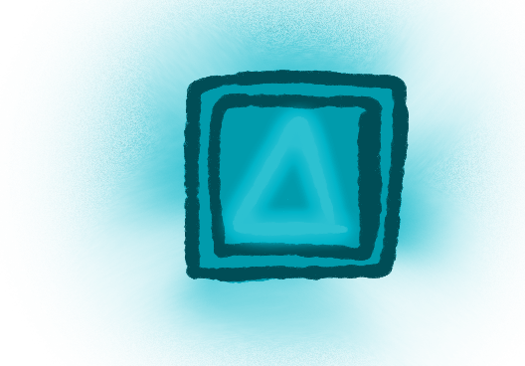

Puzzles
In Lullaby there are various types of puzzles that utilize different aspects of the singing mechanic:
Physics Puzzles:
Throughout the dungeon, several objects that are influenced by your song.
This puzzle type of one of the earliest you encounter, and thus objects will often only require a single note to be activated.
Experimentation and surprise are important qualities of the game, so perhaps sometimes objects should have different behaviours than the player has become used to.
Sequence Puzzles:
These objects require players to input a certain melody or chord(s) in the right order and with certain time restraints. Being puzzles themselves, these objects are separate from physics objects.
Examples could be doors or gates.
Hints for these sequences may be found in the environment or on the objects themselves.
Pressure-Sensitive Puzzles:
Using the pressure-sensitivity of the controller, some puzzles will also require you to sing at a certain level to progress. This could for example be singing softly to beckon an animal, singing loudly to break glass or to light up a room just enough to not disturb the monsters sleeping in the corners.

Slide 5
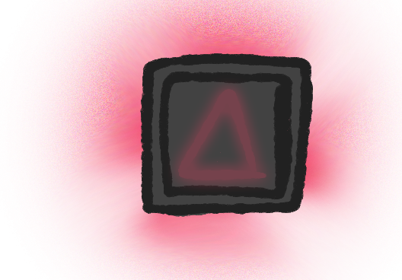
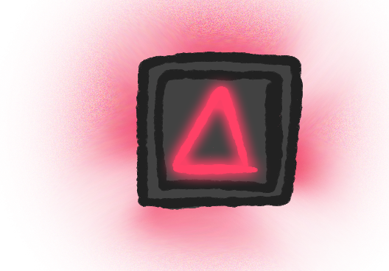

Auras and Symbols
When the player enters a room,, they see many objects, where only some are interactable. Using auras, symbols or both, we can guide the player towards possible interactions.
Awakening Auras
To reveal interactable objects, the player can sing (or perhaps hum?) to reveal the auras of interactable objects, in their respective colours. This aura will gently fade over time, but should allow players to get a good sense of the options they have.
If uncluded, symbols will also glow slightly, though not as much as when the object is activated through song.
Multi-Coloured Auras and Sequences
When an object requires a chord or sequence to be played, multi-coloured auras and multiple/layered symbols appear.
For hidden melody puzzles, where melody clues are to be found in the environment, the auras of the object appear as blank, only displaying the amount of notes needed for sucessful interaction.

Slide 6

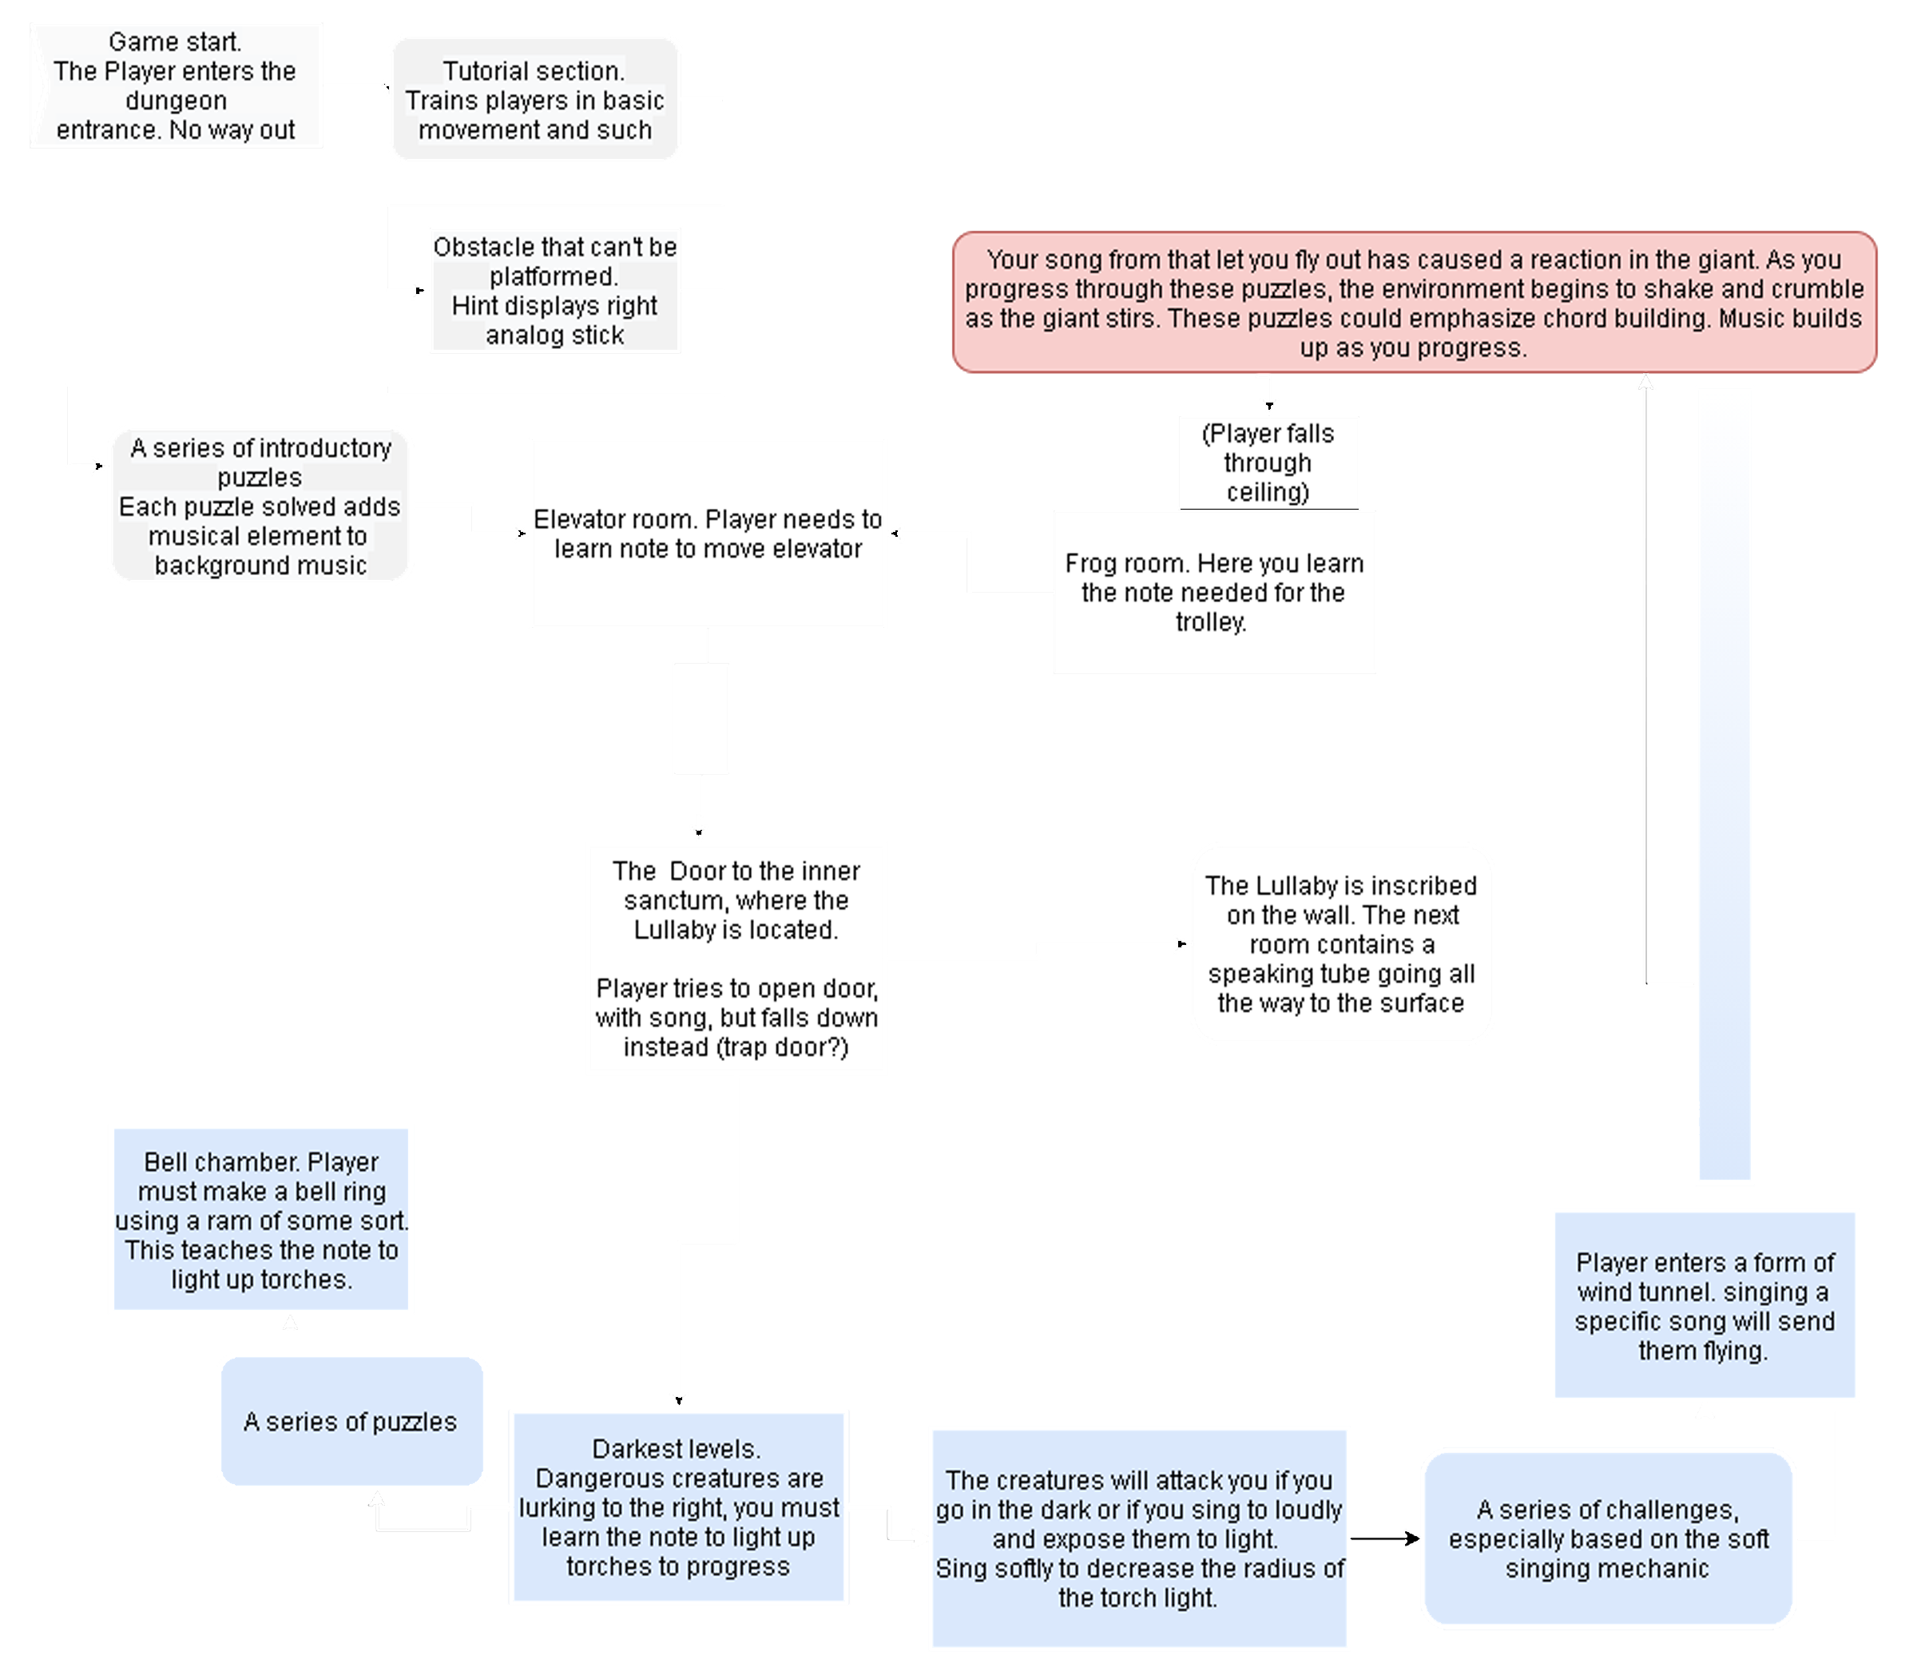
Game Structure
Proposed Structure
This is a proposal for how the game could be structured, wherein levels can be added as is desired and possible.

